Slide 1



Slide 2
Java Script
Learning Objectives
  Demonstrate the ability validate Web pages using Java script and DOM.

Slide 3

Problem statement

Slide 4
Problem statement
Knowledge and Skills Required.
  Java Script
    Importance of Java Script.
    Event Handlers.
    Document Object Model.
    Client Side Validation.

Slide 5
What is JavaScript?
JavaScript was designed to add interactivity to HTML pages
JavaScript is a scripting language (a scripting language is a lightweight programming language)
A JavaScript consists of lines of executable computer code
A JavaScript is usually embedded directly into HTML pages
JavaScript is an interpreted language (means that scripts execute without preliminary compilation)
Everyone can use JavaScript without purchasing a license

Slide 6
What is JavaScript?
It supports many features of structured programming languages like C.
Java Script is Case Sensitive.
It has some built in objects like Document, Window, Date etc.
It can be included either in <head> or <body>

Slide 7
Are Java and JavaScript the Same?
NO!
Java and JavaScript are two completely different languages in both concept and design!
Java (developed by Sun Microsystems) is a powerful and much more complex programming language - in the same category as C and C++.

Slide 8
Differences
Java
JavaScript
Object Oriented
Strongly Typed
Supports Static & Dynamic binding
Availability of Classes & Packages
Object Based
Loosely Typed
Supports only Dynamic binding
Non availability of Classes & Packages

Slide 9
What can a Java script do?
JavaScript gives HTML designers a programming tool - HTML authors are normally not programmers, but JavaScript is a scripting language with a very simple syntax! Almost anyone can put small "snippets" of code into their HTML pages
JavaScript can put dynamic text into an HTML page - A JavaScript statement like this: document.write("<h1>" + name + "</h1>") can write a variable text into an HTML page
JavaScript can react to events - A JavaScript can be set to execute when something happens, like when a page has finished loading or when a user clicks on an HTML element
JavaScript can read and write HTML elements - A JavaScript can read and change the content of an HTML element

Slide 10
What can a Java script do? Contd…
JavaScript can be used to validate data - A JavaScript can be used to validate form data before it is submitted to a server, this will save the server from extra processing
JavaScript can be used to detect the visitor's browser - A JavaScript can be used to detect the visitor's browser, and - depending on the browser - load another page specifically designed for that browser
JavaScript can be used to create cookies - A JavaScript can be used to store and retrieve information on the visitor's computer

Slide 11
Structure of Java Script
<html>
<body>
<script language="JavaScript">
document. write("Hello World!")
</script>
</body>
</html>
JavaScript in a page will be executed immediately while the page loads into the browser. This is not always what we want.
Sometimes we want to execute a script when a page loads, other times when a user triggers an event.

Slide 12
Structure of Java Script
Scripts in the head section: Scripts to be executed when they are called, or when an event is triggered, go in the head section. When you place a script in the head section, you will ensure that the script is loaded before anyone uses it.
Scripts in the body section: Scripts to be executed when the page loads go in the body section. When you place a script in the body section it generates the content of the page.
<html>
<head> </head>
<body>
<script type=“javascript">
....
</script>
</body>

Slide 13
Structure of Java Script
3. Scripts in both the body and the head section: You can place an unlimited number of scripts in your document, so you can have scripts in both the body and the head section.
<html>
<head>
<script type="text/javascript">
....
</script>
</head>
<body>
<script type="text/javascript">
....
</script>
</body>

Slide 14
EXAMPLE
Example5.1
<HTML>
<BODY>
<SCRIPT LANGUAGE="javascript">
<!--
document.writeln("<H2 ALIGN=center><B>Hi! This is Java Script and your browser supports it.</H2></B>")
//-->
</SCRIPT>
<NOSCRIPT>Java Script is not supported by your browser.
</NOSCRIPT>
This text is out side the script tag in the body section
</BODY>
</HTML>

Slide 15
Applications
JavaScript is a client-side language, which means all the action occurs on the client's (reader's) side of things. This means that no trips to the server are required for Java Scripts to kick into operation, which would slow down the process enormously. JavaScript operations are usually performed instantaneously.
In fact, JavaScript is often used to perform operations that would otherwise encumber the server, like form input validation. This distribution of work to the relatively quick client-side service speeds up the process.
Java Scripts are integrated into the browsing environment, which means they can get information about the browser and HTML page, and modify this information, thus changing how things are presented on your screen.
They can also react to events, such as when the user clicks their mouse, or points to a certain page element. This is also a very powerful ability.

Slide 16
Dialog Boxes
Alert – This Dialog box is used to display an alert message.
  Eg: alert(“Hello world”);
Confirm – This Dialog box is used to confirm the message from user. It will return true/false.
  Eg: x=confirm(“Do you want to rename”);
Prompt – This Dialog box is used to take input from the user. Input value is stored in a variable.
  Eg: a=prompt(“Enter a value”);

Slide 17
Event Handlers
Some Event Handlers :
onBlur
onChange
onClick
onFocus
onMouseDown
onMouseover
onMouseup

Slide 18
EXAMPLE
Example5.2
<HTML>
<BODY>
<script language="javascript"><!--
function message()
{
alert("Hey It's working!");
}
//--></script>
<A HREF="example5.3.html” onclick="message()">Hello!Click me </A>
</BODY>
</HTML>

Slide 19
Document Object Model (DOM)
The document itself is an object, made up of other objects like forms, images and tables. Form objects are also made up of even more objects like text boxes and submit buttons.
All of these objects have properties, with values that define their color, their length etc. JavaScript can read these properties and modify them, or react to events that happen to the objects, instantly changing the object in the browser window.
A script can respond to user interaction with the page or can run all by itself.

Slide 20
Document Object Model
Window
DOCUMENT
FRAMES
HISTORY
LOCATION
NAVIGATOR
Anchors
FORMS
BUTTON
TEXT
HIDDEN
PASSWORD
TEXTAREA
CHECKBOX
RADIO
SUBMIT
LINKS

Slide 21
DOM
The DOM defines a standard way for manipulating and accessing HTML documents.
These are some of the objects of java script :
  Window
    Document
    Event
    Frames
    History
    Location
    Navigator

Slide 22
DOM
Object | Description
Window | The object relates to the current browser window
Document | An object that contains the various HTML Elements. It relates to the body tag.
Frames | An array of frames if the window object contains any. Each frame in turn refer to another Window object.
History | Contains the current windows history list, namely, the collection of the various URL visited by the user recently.
Location | Contains the current location of the document being viewed in the form of an URL and its constituent pieces.
Navigator | An object that describes the basic characteristics of the browser

Slide 23
DOCUMENT OBJECT
This object represents a web page
It is used to access all the elements on the web page.
This is a part of window object
It can be accessed through the window. Document property.

Slide 24
DOM contd...
Document
    All
    Anchor
    Anchors
    Applet
    Applets
    Embeds
    Forms
    Frames
    Image
    Images
    Link
    Links
    Scripts
    Selection

Slide 25
DOM contd..
  Form
Button Checkbox Elements Fileupload Hidden Option | Password Radio Select Submit Text Textarea

Slide 26
WINDOW OBJECT
This object is nothing but the browser window
It is created automatically whenever a <body> tag or <frameset> tag is used in the HTML document
It is the Root object for all other objects

Slide 27
EXAMPLE
Example5.3
<HTML>
<head>
<script language="javascript"><!--
function goto_esupport()
{ winRef=window.open("http://esupport.satyam.com/","esupport", "resizable='no'", "yes");
}
function exit_esupport()
{
winRef.close();
}
//--></script>
</head>

Slide 28
HISTORY OBJECT
  Created automatically by the Java Script runtime engine.
  It consists of a series of URLs that the user has visited in a browser window.
  It is a part of window object and is accessed through the window.history property.

Slide 29
LOCATION OBJECT
This object is created automatically by the Java Script runtime engine.
It contains information about the current URL.
This is accessed through the window.location property

Slide 30
NAVIGATOR OBJECT
This object is created automatically by the Java Script runtime engine.
It contains information about the client’s browser
This is accessed through the ‘window.navigator’ property

Slide 31
METHODS OF DATE OBJECT
Date()
getDate()
setDate()
getDay()
setDay()

Slide 32
EXAMPLE
Example5.4
<HTML>
<BODY>
<script language="javascript"><!--
function display_date()
{
var d=new Date();
var day=d.getDate();
var month=d.getMonth()+1;
var year=d.getYear();
alert("today's date is \n"+day+"-"+month+"-"+year);
}
//--></script>
<input type="button" value="date" onclick="display_date()">
</BODY>
</HTML>

Slide 33
VALIDATIONS
Validating the form fields is one of the most important features of javascript.
These validations help us in checking whether users are entering correct data or not.
Validations can be done in two ways.
  validating every field individually.
  validating all fields while submitting the form.

Slide 34
EXAMPLE
Example5.5
<html>
<head>
<script language="javascript"><!--
function validate()
{
var name=document.loginfrm.user.value;
var pwd= document.loginfrm.password.value;
if(name=="" ||pwd=="")
{
alert("Please enter all fields");
return false;
}
return true;
}
//--> </script>
</head>

Slide 35
EXAMPLE contd..
<body>
<FORM name="loginfrm" onsubmit="return validate()">
User Name :<INPUT TYPE="text" NAME="user“><br>
Password :<INPUT TYPE="password" NAME="password"> <br>
<INPUT TYPE="submit" value="submit" >
</FORM>
</body>
</html>

Slide 36
EXTERNAL JAVA SCRIPT
Java script can be included in separate text file.
This way of separating javascript gives us more security.
In practice the file is saved with an extension ‘.js’

Slide 37
EXAMPLE
Example5.6
<html>
<head>
<script language="javascript" src="external.js">
</script>
</head>
<body>
<input type="button" value="click“ onclick="sayHello()">
</body>
</html>

Slide 38
EXTERNAL JAVA SCRIPT Contd…
function say Hello()
{
alert ("Hello!");
}

Slide 39
Task
Functional Requirements:
Design the form as shown in the Screen Shot. (Slide 2)
Implement the Client side Validations for all the controls mentioned in the field Description.

Slide 40
DATA TYPES
Numbers
Arrays
Strings
Objects

Slide 41
OPERATORS
Arithmetic Operators ( + , -, * , / , %)
Assignment Operators(=,+=,-=,*=,/=,%=)
Comparison Operators (==,!=,<,<=,>,>=)
Boolean Operators(&&,||,!)
Bitwise Operators(&,|,!,^,<<,>>,>>>)
String Operators(=,+,+=)

Slide 42
Control Structures

Slide 43
IF STATEMENT
if (condition)
{
//code to be executed.
}
else (condition)
{
//code to be executed.
}

Slide 44
SWITCH STATEMENT
Switch (expression)
{
Case value1: Code to be executed ;
Break;
Case value2: Code to be executed ;
. Break;
.
.
Default: Code to be executed;
Break;
}

Slide 45
LOOPS
For Loop:
for(initialization;condition;increment/decrement)
{
//code to be executed
}
While Loop:
while(condition)
{
//code to be executed
}
Do-While Loop:
do
{
//code to be executed
        }while(condition);

Slide 46
EXAMPLE
Example5.7
<html>
<body>
<script language="javascript"><!--
var no=prompt(“Enter a number” ,” ”);
if(no>5)
document.write(“You have entered a number greater than five.”);
else
document.write(“You have entered a number lessthan or equal to five”;
//--></script>
</body>
</html>

Slide 47
FUNCTIONS
We can also write functions in Java script.
Syntax for writing a function is…
function function_name([arg1[,arg2[,arg3[,…]]]])
{
//code to be executed
[return (return_value);]
}

Slide 48
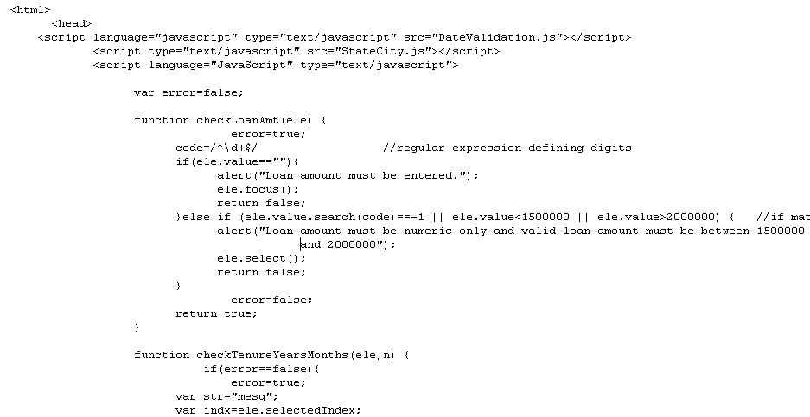
FORM VALIDATION USING JAVASCRIPT

Slide 49
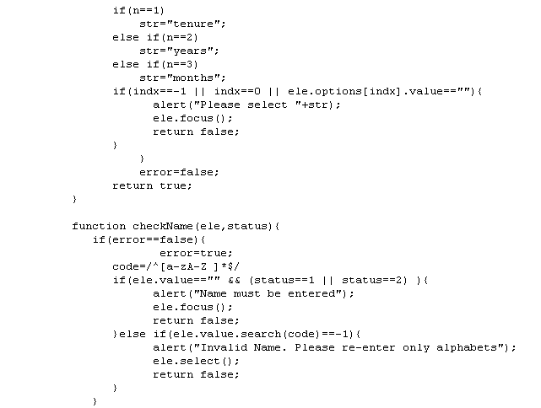
FORM VALIDATION USING JAVASCRIPT

Slide 50
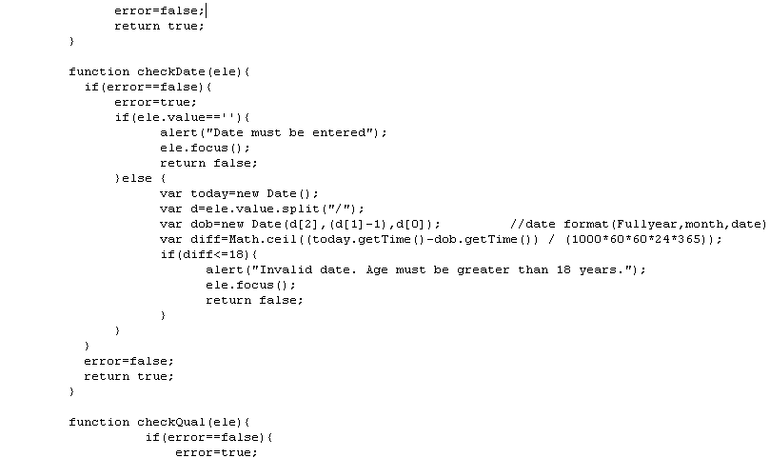
FORM VALIDATION USING JAVASCRIPT

Slide 51
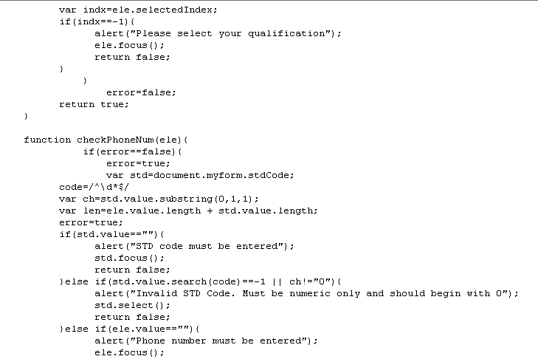
FORM VALIDATION USING JAVASCRIPT

Slide 52
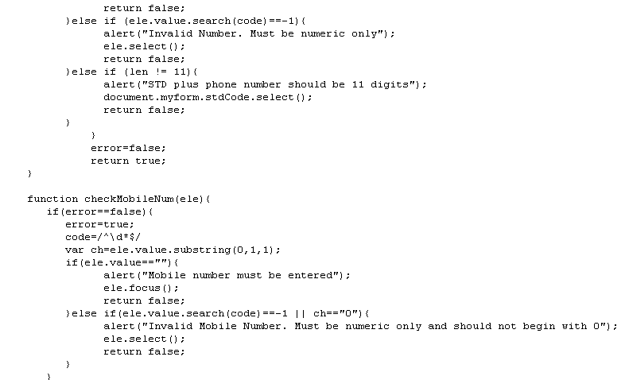
FORM VALIDATION USING JAVASCRIPT

Slide 53
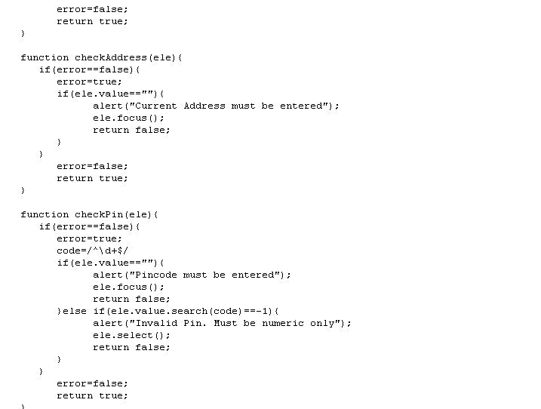
FORM VALIDATION USING JAVASCRIPT

Slide 54
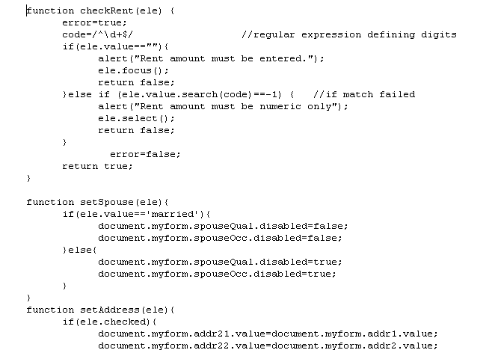
FORM VALIDATION USING JAVASCRIPT

Slide 55
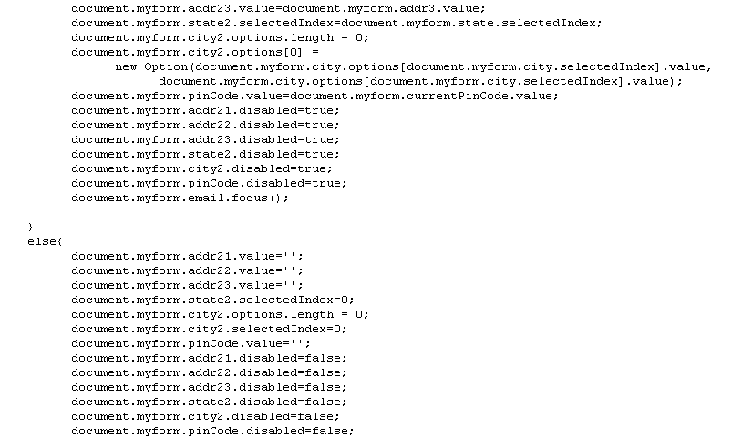
FORM VALIDATION USING JAVASCRIPT

Slide 56
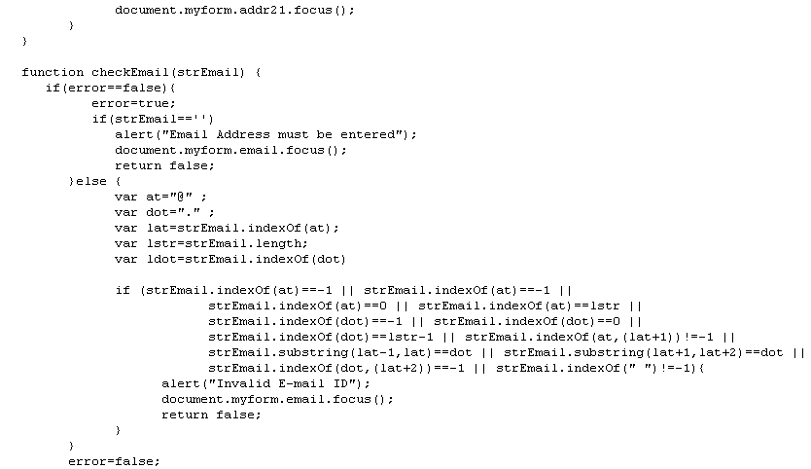
FORM VALIDATION USING JAVASCRIPT

Slide 57
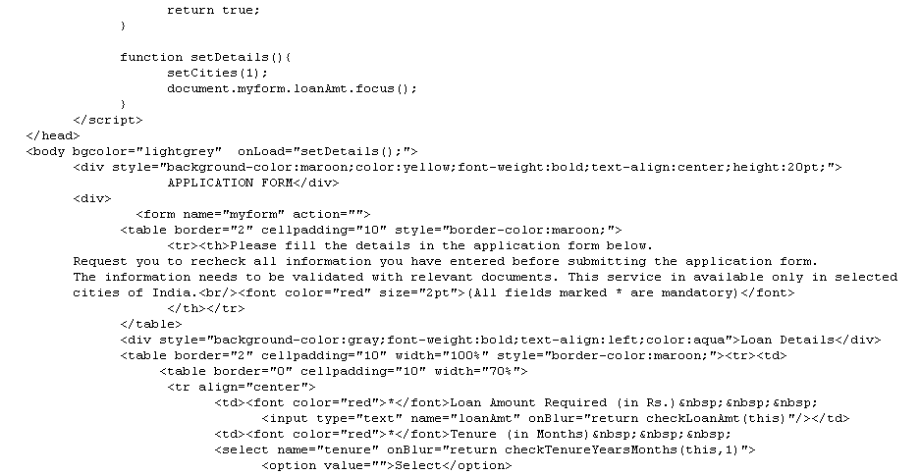
FORM VALIDATION USING JAVASCRIPT

Slide 58
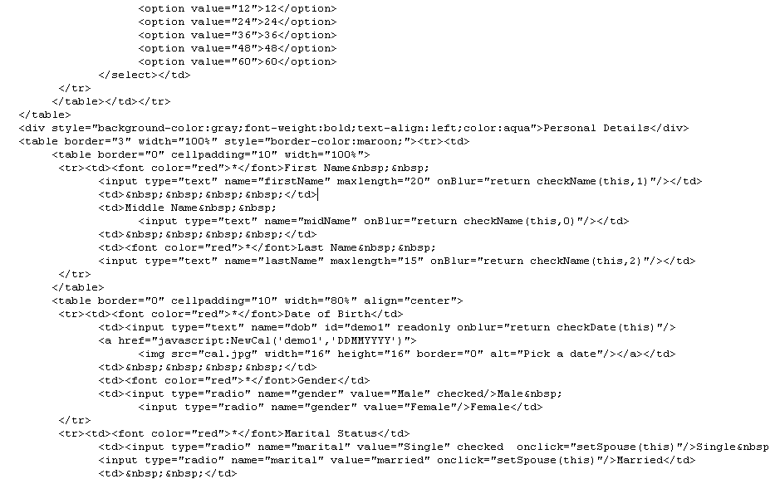
FORM VALIDATION USING JAVASCRIPT

Slide 59
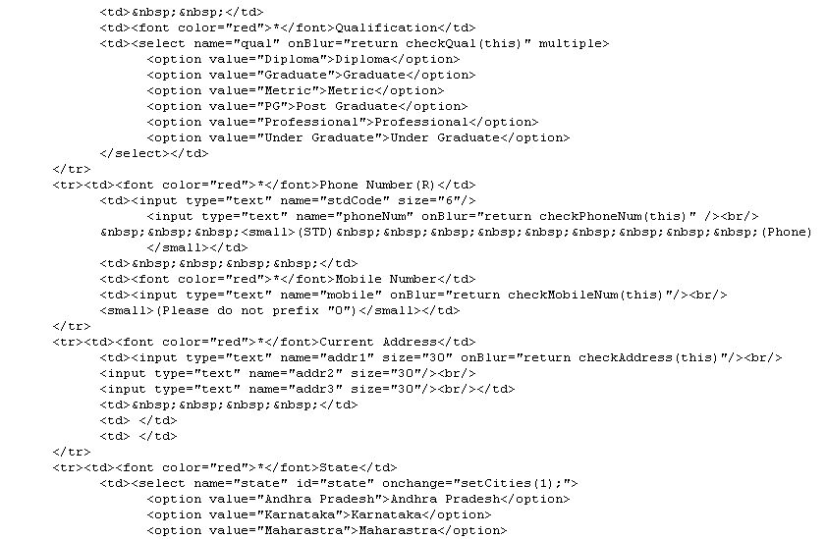
FORM VALIDATION USING JAVASCRIPT

Slide 60
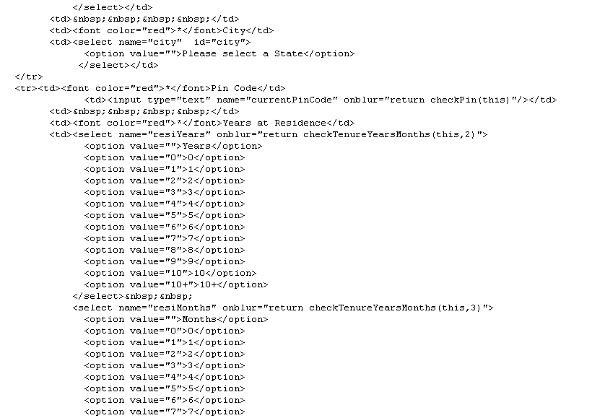
FORM VALIDATION USING JAVASCRIPT

Slide 61
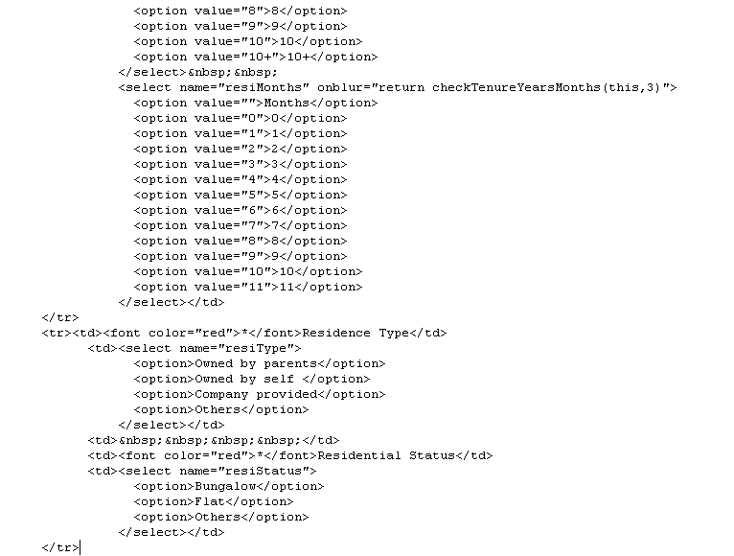
FORM VALIDATION USING JAVASCRIPT

Slide 62
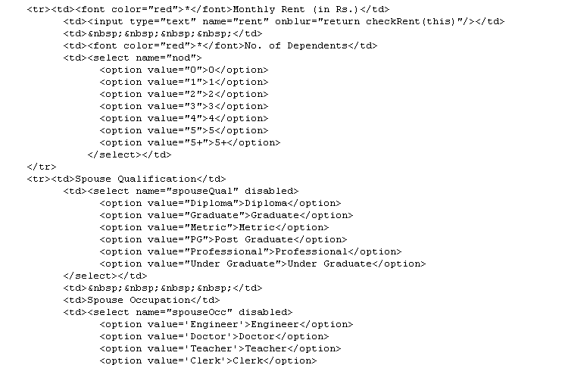
FORM VALIDATION USING JAVASCRIPT

Slide 63
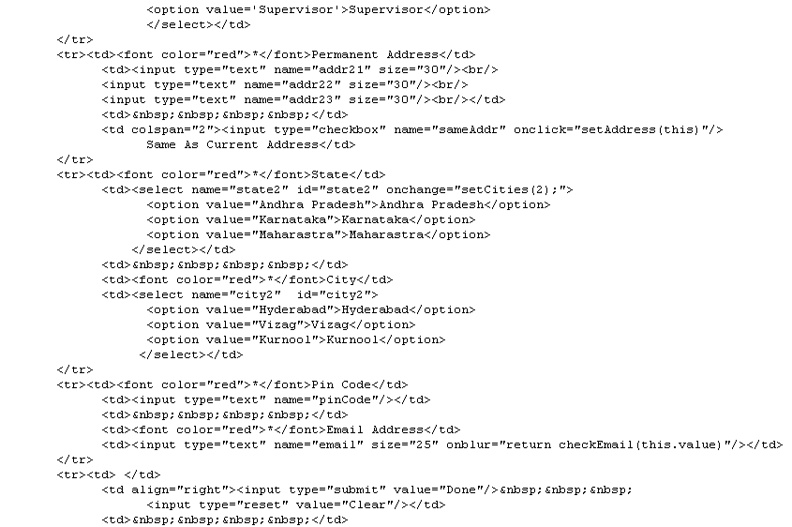
FORM VALIDATION USING JAVASCRIPT

Slide 64
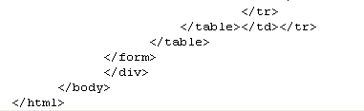
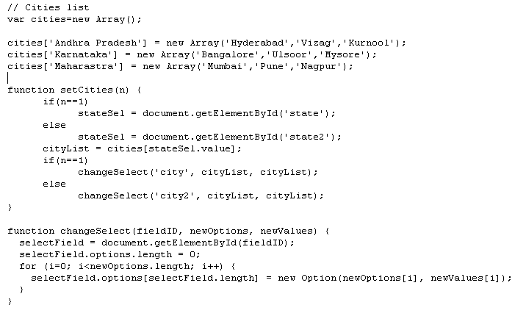
FORM VALIDATION USING JAVASCRIPT
StateCity.js

Slide 65
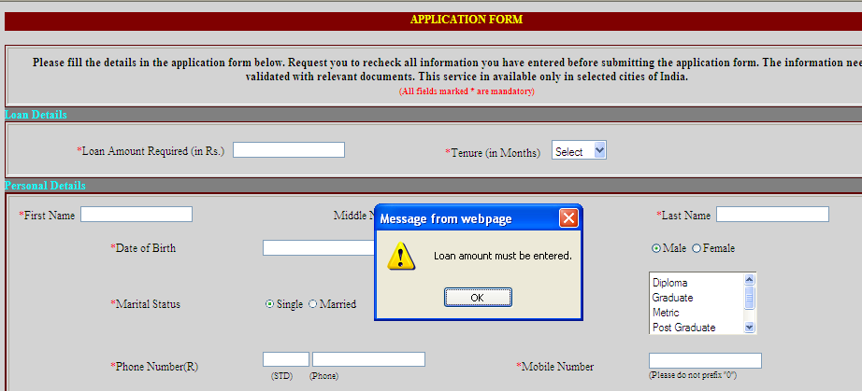
FORM VALIDATION USING JAVASCRIPT

Slide 66
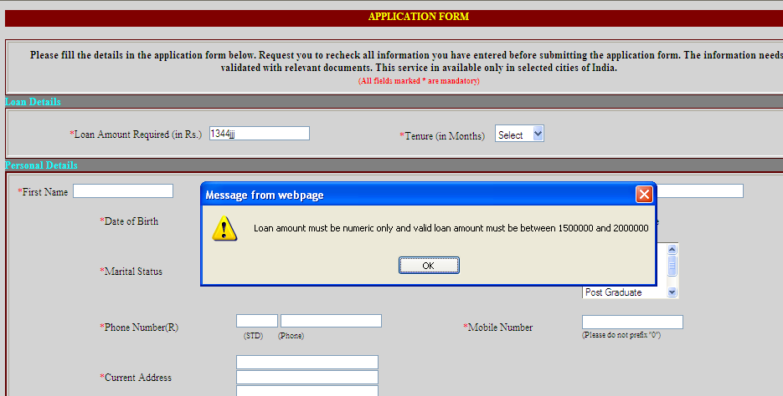
FORM VALIDATION USING JAVASCRIPT

Slide 67
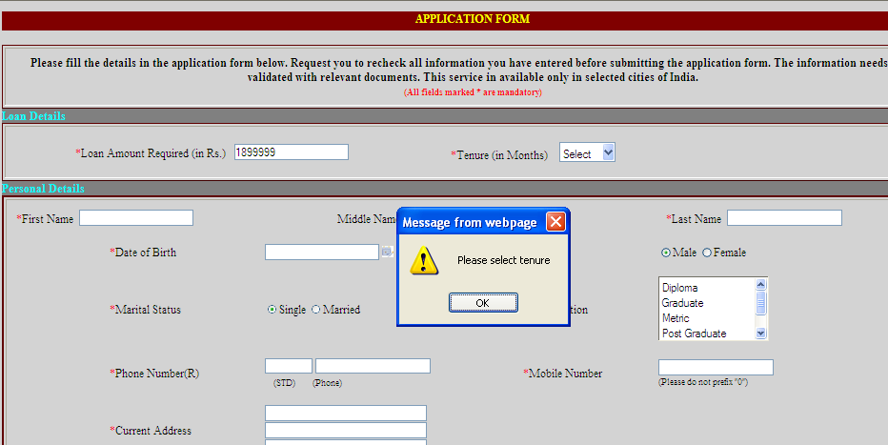
FORM VALIDATION USING JAVASCRIPT

Slide 68
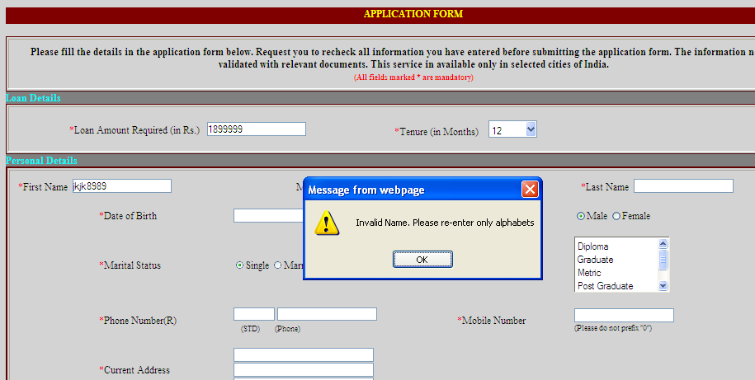
FORM VALIDATION USING JAVASCRIPT

Slide 69
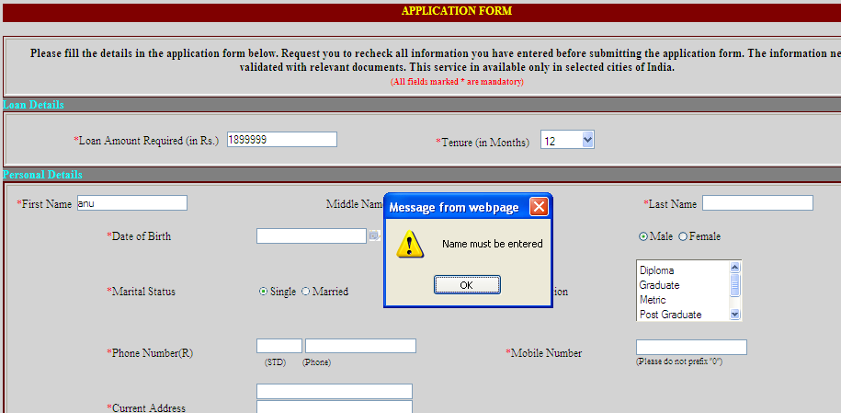
FORM VALIDATION USING JAVASCRIPT

Slide 70
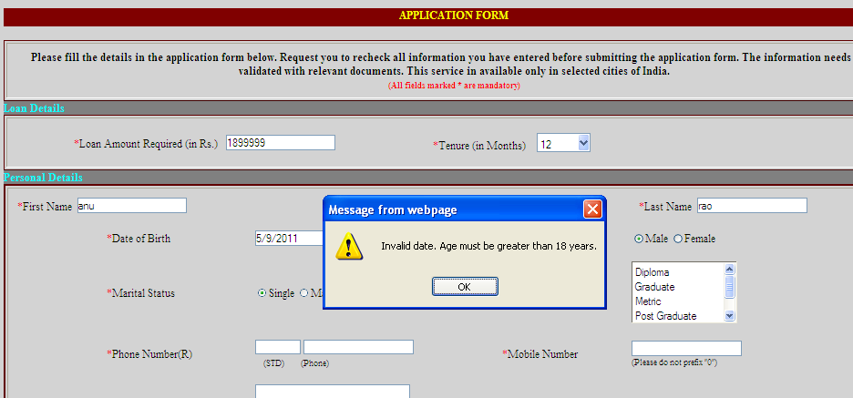
FORM VALIDATION USING JAVASCRIPT

Slide 71
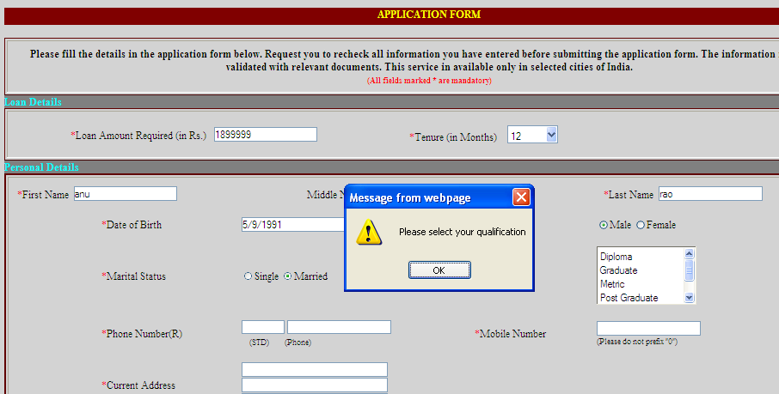
FORM VALIDATION USING JAVASCRIPT

Slide 72
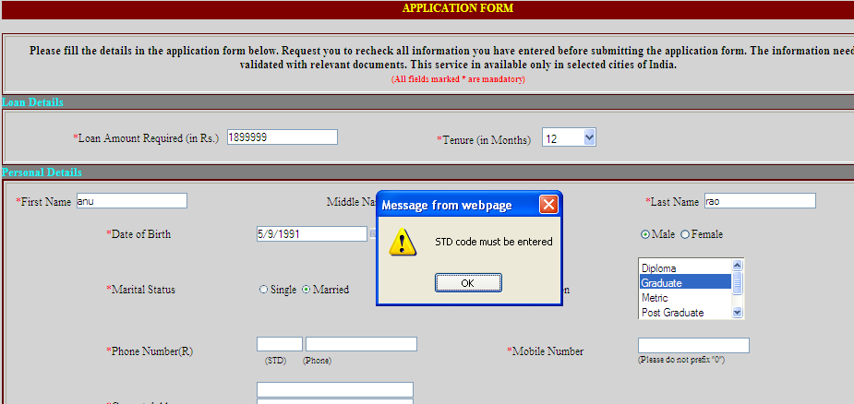
FORM VALIDATION USING JAVASCRIPT

Slide 73
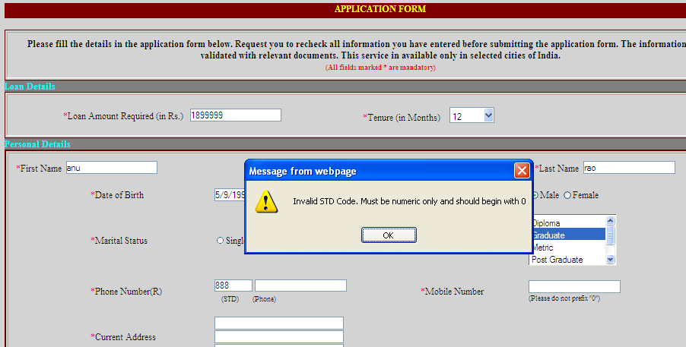
FORM VALIDATION USING JAVASCRIPT

Slide 74
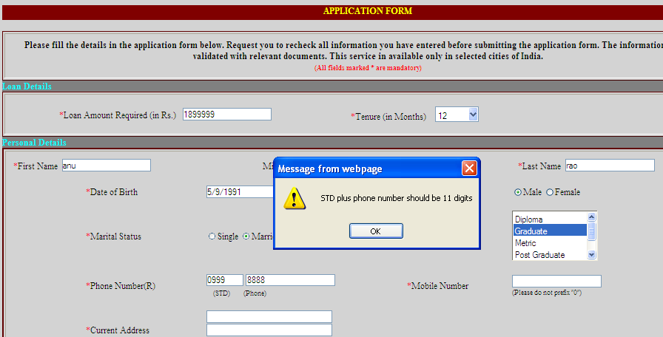
FORM VALIDATION USING JAVASCRIPT

Slide 75
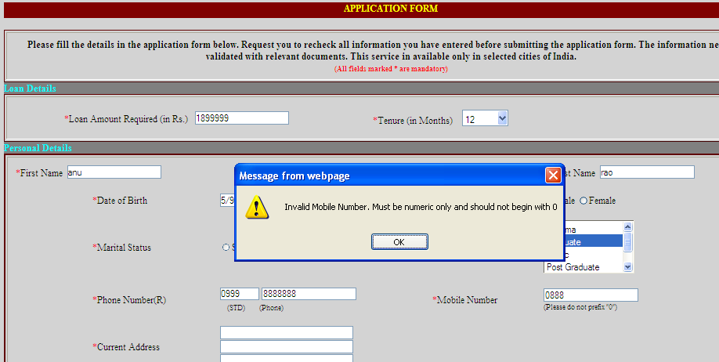
FORM VALIDATION USING JAVASCRIPT

Slide 76
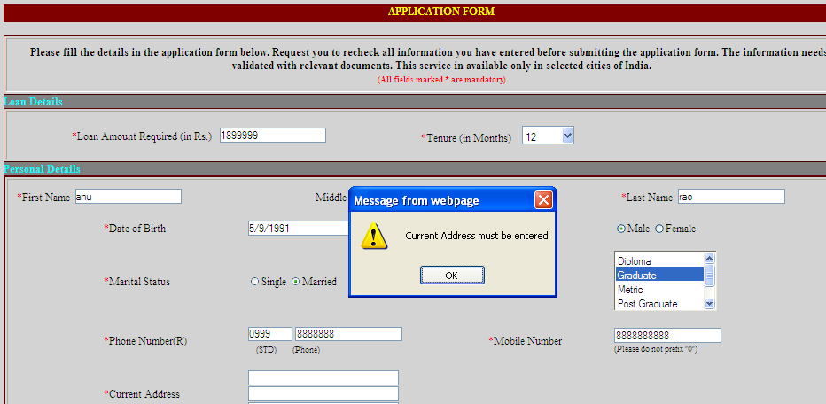
FORM VALIDATION USING JAVASCRIPT

Slide 77
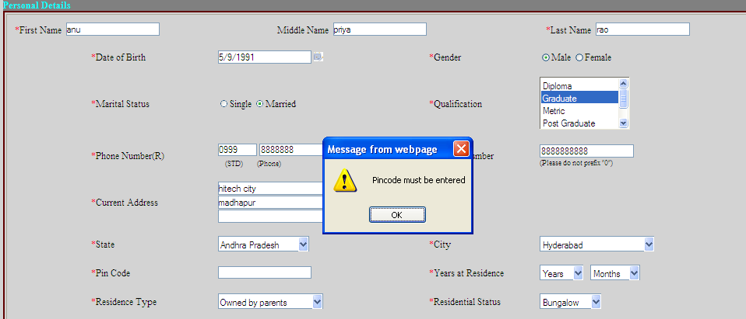
FORM VALIDATION USING JAVASCRIPT

Slide 78
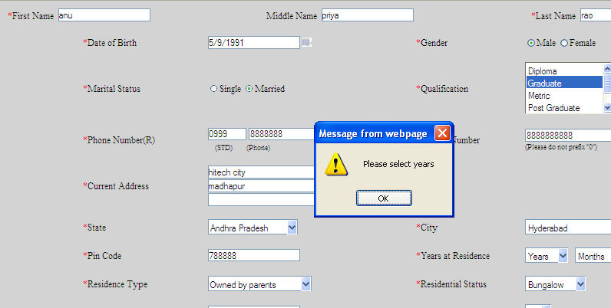
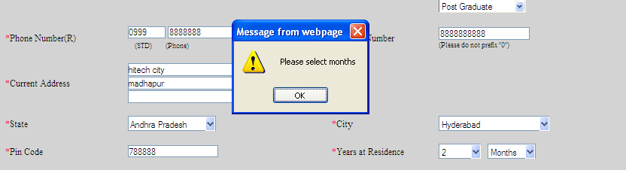
FORM VALIDATION USING JAVASCRIPT

Slide 79
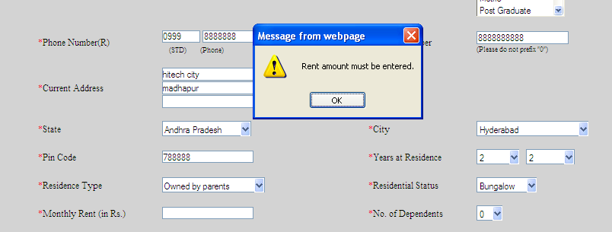
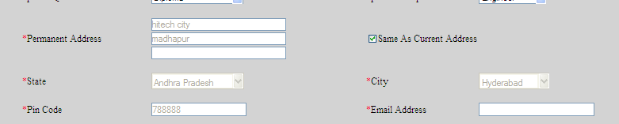
FORM VALIDATION USING JAVASCRIPT
Automatic setting of address if checkbox is clicked (non-editable now)

Slide 80
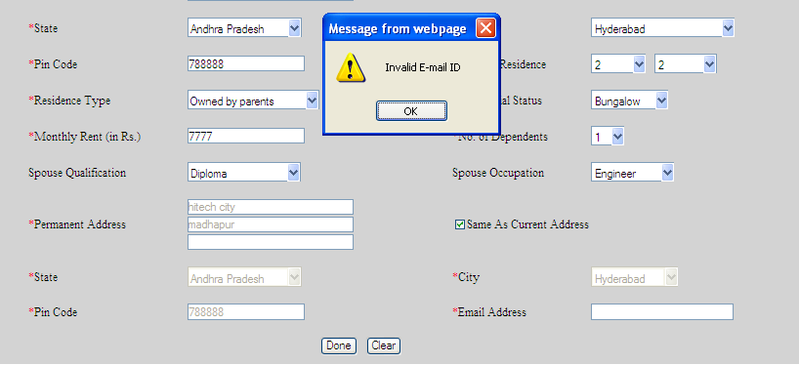
FORM VALIDATION USING JAVASCRIPT

Slide 81
ADVANCED JAVASCRIPT EXAMPLES
Menu using JavaScript
Menu that can move along with your mouse pointer
Scroll down Menu that will scroll down into your page
A sample fading text
A script that creates a select box as you wish
A menu that slides on mouseover
A menu with fading effect

Slide 82
Thank you
Visit us at www.techmahindra.com

